Slide 1
University Management System – Alumni Management Module
Internship Project
Group no:14
Roll Number | Student Name
Karen Rena C | 20211CSD0169
Samprity Singha | 20211CSD0044
Nandini | 20211CSE0456
Piyush R | 20211CSE0651
Samrudd | 20211CSD0172
Under the Supervision of,
Dr. Jayanthi Kamalasekaran
Associate Professor
PSCS
Presidency University
Name of the Program: B. Tech - CSE
Name of the HoD: Dr. ASIF MOHAMED H B
Name of the Department Project Coordinator: Mr. Jerrin Joe Francis
Name of the School Project Coordinators: Mr. Md Ziaur Rahman/Dr. Sampath A K

Slide 2
Introduction
The "Alumni Management Module" is an enterprise-grade web application developed under Tech Mahindra’s campus training initiative at Presidency University. This project was driven by the need for a centralized digital platform that strengthens engagement between the institution and its alumni community.
Built with Spring Boot, Thymeleaf and MySQL, the system integrates role-specific functionalities, secure access control, and responsive user design. It empowers administrators to manage alumni profiles, events, and communication, while alumni can update profiles, register for events, and stay connected.
This real-world development experience bridged academic learning with industry practices and delivered a scalable solution aligned with professional software engineering workflows.

Slide 3
Literature Review
Contemporary alumni management systems have transitioned from manual databases to interactive, secure, web-based platforms. Literature emphasizes centralized access to alumni data and enhanced user experience through responsive design. Several studies stress the need for real-time communication, highlighting the role of integrated messaging systems and APIs like LinkedIn for auto-updated profiles.
Privacy and security are recurring themes, with best practices involving encrypted logins, controlled access rights, and secured data hosting. Role-based architectures, like those implemented in our project, are considered optimal for organizing system privileges and workflows.
However, research also points out that a significant number of existing systems fail to deliver a truly interactive alumni experience, lacking features like mentorship programs, real-time dashboards, or modular scalability. These findings strongly informed our design choices, encouraging the adoption of robust frameworks and user-centric features.

Slide 4
Literature Review
Several studies stress the need for real-time communication, highlighting the role of integrated messaging systems and APIs like LinkedIn for auto-updated profiles. Technical architectures commonly adopt layered models, separating concerns across controllers, services, and data layers. Systems employing HTML, JavaScript, and Java-based frameworks (such as Spring Boot) show superior maintainability and performance.
Importantly, privacy and role-based access remain critical, with many implementations favoring JPA-managed databases and encrypted authentication to ensure security and compliance.

Slide 5
Research Gaps Identified
1. Legacy Design and Manual Data Handling:
Many existing Alumni Management Systems (AMS) continue to rely on outdated architectures and manual processes, such as Excel-based data storage. This approach introduces risks of inconsistency, limited multi-user access, and slow information retrieval.
2. Poor Mobile Responsiveness: A lack of responsive design makes many AMS platforms difficult to access via smartphones or tablets. This is especially problematic given that most users especially younger alumni, expect mobile-first usability in modern applications.
3. Limited User Interactivity: Current systems often restrict communication flows, allowing alumni-student interactions only via administrative approval. This bottleneck prevents natural mentoring opportunities and diminishes active engagement within the alumni network.

Slide 6
Research Gaps Identified
4. Lack of Social Media and External Integrations: Social platform connectivity, such as LinkedIn API integration—is either missing or improperly implemented. This restricts automated profile updates and diminishes the system’s appeal and long-term utility.
5. Guiding the Proposed System: These persistent issues directly shaped our design choices. The proposed system addresses these gaps with a secure, mobile-responsive, role-driven architecture that enables real-time communication, scalable modularity, and potential for future integrations.

Slide 7
Proposed Methodology
1. Requirement Analysis
The process began with stakeholder interviews involving administrators, students, and technical staff. Functional and non-functional requirements were gathered to ensure system relevance and feasibility. Core functionalities identified included alumni registration, profile management, secure login, event management, and admin communication.
2. Full Stack Development
The system was built using a Java-based full-stack architecture. Spring Boot facilitated rapid backend development with built-in dependency management and embedded Tomcat server. Spring MVC was used to separate concerns across controllers, services, and repositories
3. Frontend Integration
Thymeleaf was used as a server-side templating engine to dynamically render HTML content. UI templates adapted to user roles (Admin/Alumni) were implemented for seamless navigation and personalized experience.
4. Database Management
MySQL served as the relational database for storing user data, events, messages, and logs. Spring JPA (Hibernate) enabled automatic schema generation, object-relational mapping (ORM), and simplified query operations.

Slide 8
Proposed Methodology
5. Security Enforcement
Spring Security provided role-based access control and session authentication. Passwords were encrypted using BCrypt hashing, and admin/alumni roles were strictly enforced via route restrictions and annotations.
6. Collaboration and Testing
GitHub was used for version control, collaborative development, and issue tracking. Integration and unit tests were written to verify business logic and ensure stability across modules during development.

Slide 9
Objectives
1.Centralized & Secure Architecture
The system was designed as a centralized, web-based platform to manage alumni data securely. It incorporates role-based access and Spring Security for encrypted login, password protection (using BCrypt), and authorization protocols.
2. Layered Backend Design
The backend architecture follows the Model-View-Controller (MVC) pattern with service-based separation of concerns. Business logic, database access, and controller functions are modularized to improve maintainability and scalability.
3. Scalable and Extensible System
Scalability is achieved through Spring Data JPA repositories and DTO (Data Transfer Object) patterns. This enables future integration of new modules such as mentorship systems, alumni donations, job boards, and social media APIs like LinkedIn.
4. Responsive Front-End Interface
The front-end UI is developed using Thymeleaf templates with Bootstrap and custom CSS, ensuring a responsive, mobile-friendly experience. Pages are designed separately for admin and alumni roles to ensure clarity and targeted interaction.

Slide 10
Objectives
5. Clearly Defined User Roles
Admins: Full CRUD privileges for alumni and event records, messaging capabilities, and activity logs.
Alumni: Role-restricted to self-profile management, event registration, and messaging admin only.
6. Full-Stack Java Implementation
The system is built using Spring Boot and Spring MVC on the backend, enabling rapid setup and development. Thymeleaf is used for rendering dynamic views, integrated seamlessly with backend data.
7. Robust Database & ORM
MySQL is used as the relational database system. Spring JPA provides seamless object-relational mapping, handling entity relationships such as alumni-event participation through annotated models.
8. Secure Session Management
Spring Security governs all session activities, including login, logout, and access restrictions. Role-based annotations (eg @PreAuthorize) are used to prevent unauthorized access to sensitive endpoints.
9. Collaborative Development Workflow
The project was collaboratively built using GitHub for version control, code review, and issue tracking. Testing involved both unit tests for services and integration tests for controller-service flows

Slide 11
System Design & Implementation
1. MVC-Based Architecture
The system uses Model-View-Controller (MVC) architecture to ensure separation of concerns, enabling maintainable and scalable code
2. Controller Layer
Handles user HTTP requests and delegates tasks to services.
3. Service Layer
Implements business logic for alumni registration, event creation, and profile management using AdminServiceImpl and AlumniServiceImpl
4. Repository Layer
Spring Data JPA abstracts SQL via JpaRepository. Custom queries simplify DB access.
5. Entity Layer
Entities like Alumni, Event, Message refine the relational structure and map directly to MySQL tables.
6. Thymeleaf View
Dynamic role-based HTML rendering with Thymeleaf. Admin and alumni dashboards adapt content via logic-bound templates.
7. Security & Logging
Spring Security governs role-based access. All changes are logged in activity_log for auditing.

Slide 12
System Design & Implementation
Admin Module
Authentication: Admin login via Spring Security with encrypted (BCrypt) credentials.
CRUD Operations: Manage alumni and events via endpoints like /admin/edit/{id}
Messaging: Compose/respond to alumni via messages table handles by MessageService
Audit Trail: All admin actions logged for accountability. Access restricted using hasRole("ADMIN")
Alumni Module
Registration & Approval: Alumni register via form, approval needed by admin to activate login.
Dashboard Access: Role-based dashboard alumni_dashboard.html with event listings and profile editor.
Event Participation: Many-to-many table relation allows alumni to view and register for events.
Secure Messaging: In-app form links to contact_message table to enable admin-alumni communication.
Data Validation: Handled both client-side (JavaScript) and server-side (Java validation).

Slide 13
System Design & Implementation
Layered System Architecture
1. Model Layer Defines JPA-mapped entities like alumni, admin, event , message Ensures DB normalization and integrity.
2. Repository Layer
JpaRepository interfaces like AlumniRepository provide easy CRUD access and auto-query generation.
3. Service Layer Handles workflows such as profile updates, event management, and messaging. Central logic layer between controller and repository.
4. Controller Layer Manages user actions through routes (/register, /events) and passes validated data to services.
5. View Layer Built using Thymeleaf with Bootstrap for responsive UI. Dynamic content rendered based on roles and backend data.
6. Security & Deployment Spring Security ensures access control and encrypted credentials. App deployed via embedded Tomcat using Spring Boot

Slide 14
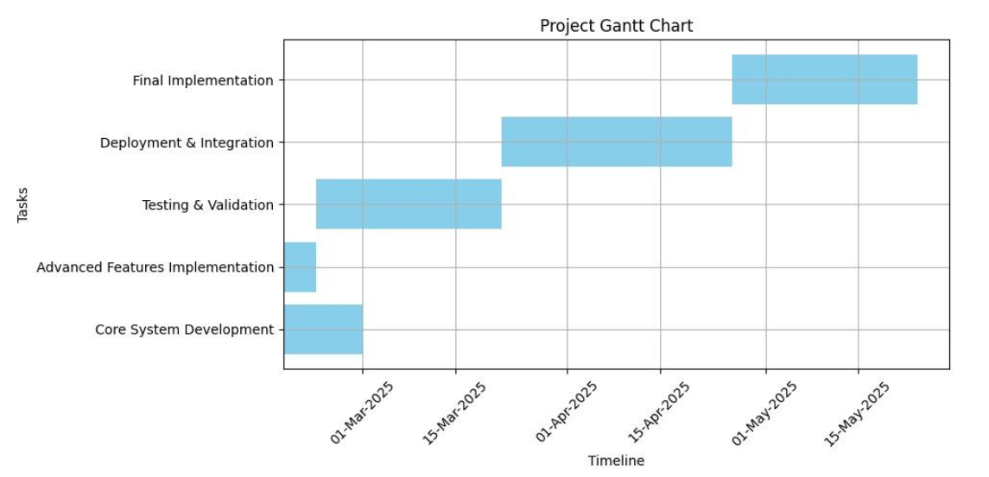
Timeline of Project

Slide 15
Results Obtained
1. Responsive, User-Centric Design
The system delivers a clean, intuitive, and mobile-responsive user interface, ensuring seamless interaction across devices. Both admin and alumni users benefit from role-specific dashboards, accessible via desktop and mobile browsers.
2. Complete CRUD Functionality Full support for Create, Read, Update, and Delete operations was implemented for alumni profiles and event records. Admins can add, edit, or remove users and events dynamically through secure web forms, while alumni can update their profiles post-login.
3. Secure Role-Based Access Control Integrated Spring Security enables end-to-end session handling with BCrypt password hashing. The system strictly separates admin and alumni roles, allowing only authorized users to access specific routes and functions.
4. Seamless Communication Module A built-in messaging system allows two-way interaction between alumni and administrators. Messages are securely stored and retrieved via database-backed services, promoting feedback, support, and engagement.

Slide 16
Results Obtained
5. Public Alumni Directory A publicly viewable alumni directory increases institutional transparency and enhances visibility. Prospective students, recruiters, and peers can browse verified alumni profiles, strengthening the university’s outreach and networking potential.
6. Real-World Enterprise Practices The project reflects industry-grade development practices including modular architecture, Git-based collaboration, layered service logic, and secure deployment using Spring Boot with embedded Tomcat.

Slide 17
Conclusion
The Alumni Management System successfully delivers a secure, role-based platform that connects universities with their alumni. With modules for event participation, real-time messaging, and profile management, the system streamlines administrative tasks while promoting community engagement.
Key technical contributions include a fully layered MVC architecture, secured Spring-based authentication, dynamic UI with Thymeleaf and seamless MySQL data integration. The system’s scalability supports future enhancements like donation tracking, job board integration, and LinkedIn APIs.
While dependency on high-quality input data and session-based login mechanisms pose minor challenges, the modularity of the design allows for continuous improvements. Overall, this project reflects real-world software engineering practices, equipping the team with skills in full stack development, system design, version control, and secure application deployment.

Slide 18
References
[1] Zatke, Siddhi & Tandel, Chinmaya. (2024). Alumni Management System Using LinkedIn API. International Journal of Creative Research Thoughts (IJCRT), Volume 12, Issue 5, May2024. ISSN: 2320-2882. https://www.ijcrt.org/papers/IJCRT2405887.pdf
[2] Sawai, Parth P., Chambhare, Prajyot V., Jaysingpure, Aditya N., Karhe, Atharav G., Rathod,Disha, & Gulhane, V. S. (2024). Alumni Connect Hub: A Comprehensive Alumni Management System. International Journal of Ingenious Research, Invention and Development (IJIRID), ISSN (Online): 2583-648X. https://doi.org/10.5281/zenodo.10822623
[3] Mitali Ved, Hitakshi Tanna, Pratik Yeole, Pradnya Kamble, Alumni Management System-Web Application, Journal, I. R. J. E. T. (2022) IRJET.
[4] Radhika, A., Mayraaj, Shaik, Devisree, B., Surendra Sai, B., & Uma Ganesh, B. (2024).Alumni Management System. International Journal of Engineering Science and Advanced Technology (IJESAT), Vol. 24, Issue 05, May 2024. ISSN: 2250-3676. https://www.ijesat.com/ijesat/files/V24I0504_1714750369.pdf
[5] Lavanya, K., Supriya, Y., Bhargavi, K., Aswini, N., & SwarajyaLakshmi, G. (2021).Alumni Management System Using Web Technologies. Juni Khyat, Vol-11 Issue-01, 487.ISSN: 2278-4632. (UGC Care Group I Listed Journal). http://www.junikhyatjournal.in/no_1_Online_21/65.pdf
[6] Tarun Kumar, Yeeshu Prateek, Prajwal Atharga, Dr. Rajashekarappa, Prof. V. K. Parvati,2019, Alumni Database Management System, INTERNATIONAL JOURNAL OFENGINEERING RESEARCH & TECHNOLOGY (IJERT) NCRACES – 2019(Volume 7, Issue 10)
[7] Mukherjee, Aritra & Roy, Adrita & Lath, Manish & Ghosal, Arnab & Sengupta, Diganta.(2019). Centralized Alumni Management System (CAMS) - A Prototype Proposal. 967-971.10.1109/AICAI.2019.8701383
[8] A. A. Shinu, V. Keerthi, M. Manoj, M. Shaheer, N. S. Nair and A. John, "Customized Alumni Portal implementing Natural Language Processing Techniques," 2019 International Conference on Intelligent Computing and Control Systems (ICCS), 2019, pp. 927-931, doi: 10.1109/ICCS45141.2019.9065320.
[9] Dodake, Prajkta, Shinde, Rugved, Kakad, Makarand, Ghodke, Shital, & Shinde, T. R.(2022). Alumni Management System Solution to Alumni Database. International Journal of Engineering Research & Technology (IJERT), https://www.ijert.org/research/alumni-management-system-solution-to-alumni-database-IJERTV11IS050158.pdf
[10] Sinduja, S., Thamaraiselvi, A., Prarthana, T., Poorviga, B., Shalini, C., & Ezhilsri, K.(2024). Alumni Connect: Building Bridges Beyond Graduation Through Mobile App.International Journal of Engineering Research & Technology (IJERT), Volume 13, Issue 10,October 2024.
https://www.ijert.org/research/alumni-connect-building-bridges-beyond-graduation-through-mobile-app-IJERTV13IS100098.pdf

Slide 19
GitHub Link
https://github.com/karenrenac/Alumni-Management-System

Slide 20

Mapping project with the Sustainable Development Goals (SDGs).

Slide 21
Mapping project with the Sustainable Development Goals (SDGs).
SDG 4 – Quality Education
Your system creates a platform for alumni to stay connected, share experiences, and provide mentorship, indirectly enhancing access to education resources for current students. The alumni directory, events, and networking opportunities contribute to lifelong learning and institutional development.
SDG 8 – Decent Work and Economic Growth
By maintaining strong alumni networks, institutions can facilitate job referrals, internships, and career guidance — promoting employability and economic opportunities among students and graduates.
SDG 9 – Industry, Innovation, and Infrastructure
The system itself is a technological innovation that strengthens digital infrastructure for educational institutions. It encourages the adoption of modern tools in academic administration and alumni engagement.
SDG 10 – Reduced Inequalities
The system ensures equal opportunity for all alumni to connect and be recognized, regardless of their background or location. Public directories and open access (for viewing) reduce barriers to visibility and participation.
SDG 11 – Sustainable Cities and Communities
Alumni events and community outreach features can support civic engagement, volunteerism and social development. By strengthening alumni ties, institutions can promote active citizenship and knowledge-sharing within communities.
SDG 17 – Partnerships for the Goals
Alumni systems foster partnerships — not just among alumni, but between institutions, industries, and communities. These collaborations can lead to funding, mentoring, and capacity-building initiatives.

Slide 22
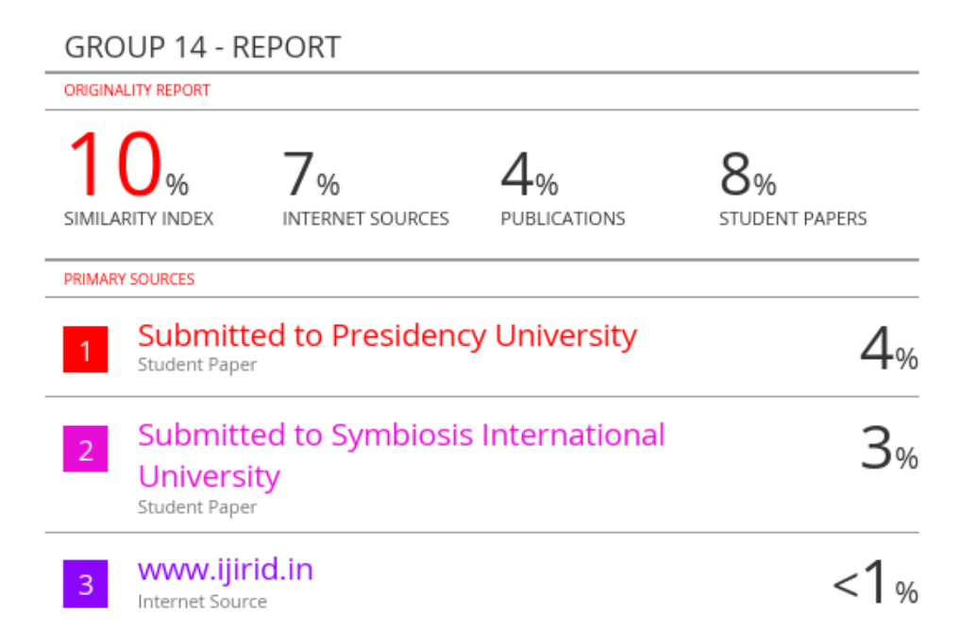
Similarity Report

Slide 23
Thank You

